Slide 1
Biology B

Slide 2
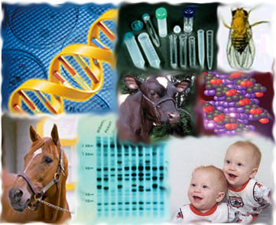
Why Study Genetics?
Genetics is everywhere these days - and it will become even more important in the future…
…so wouldn’t it be nice if people understood it better?

Slide 3
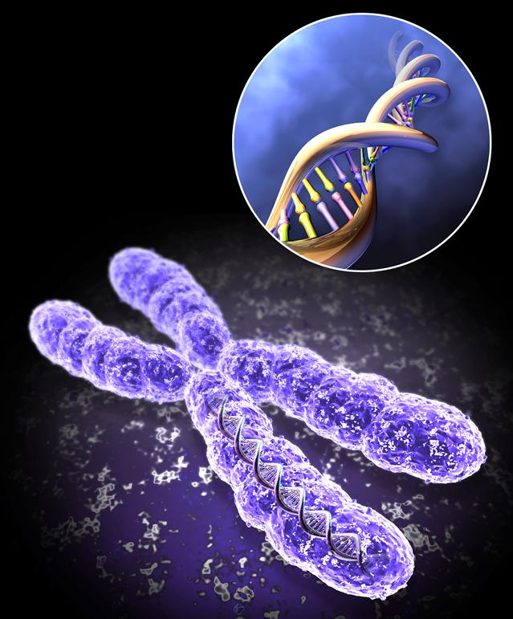
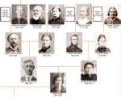
Terms to Know and Use
Genetics – the study of heredity.
Heredity – the passing of traits from the parents to their offspring.

Slide 4
Gregor Johann Mendel “Father of Genetics”
1822- 1884
Austrian monk
Experimented with pea plants
Trained in math and science
Notes:
Born 1822 to a peasant family in Moravia, part of Austrian Empire-now the Czech republic. Peasants actually held land and farmed it-3 days/week they worked for landlord. Born to Anton & Rosine. Anton grew fruit trees, experimented with grafts probably his introduction to horticulture. Father sacrificed to keep son in school –academic career. After training Mendel considered himself a physicist. The monastery of St. Thomas at Brunn in Moravia was one of the leading centers of intellectual activity in Moravia. The abbot(head) of the monastery encouraged all the members to pursue scientific interests. They were required to teach bible studies, mathematics and and Philosophy at the Philosophy Institute in Brünn. So basically the Abbott, Cyrill Napp, created this small private university. In 1943 Mendel was ask to join the monastery. Alongside his religious duties as a novice, Mendel worked under Matthaeus Klacel, a botantist carrying out plant breeding experiments at the monastery. Mendel studies for 4 years in theology completing his course in1848 and he was then assigned as a parish priest/chaplain at a nearby hospital. But working with all these sick people made him physically ill. So the Abbott moved him out to teach math and the classics at a local high school. He tried to get his teaching certificate, but failed because he had a poor grasp of biology in1850. Because he was a well liked and great instructor they kept him on and sent him for future studies at Vienna University where he studied physics, statistics and probability, atomic theory of chemistry and took bio and plant physiology courses. . At this time universities were just beginning to teach that plants were made up of cells and that plants reproduced sexually—meaning that contributions form both parents were important in the development of a new plant from seed. Mendel returned to the monastery and continued teaching high school and prevailing thought is that he never passed the teachers exam because he disagreed the the examiners ideas about plant reproduction or he had debilitating test anxiety. The prevailing idea was that most of the information for the new seed comes from the pollen grain.
Based upon their observations with ornamental plant breeding, scientists in the nineteenth century realized that both parents contribute to the characteristics of offspring. The "blending" theory then became the favored explanation of inheritance. According to this theory:
Hereditary materials from male and female parents mix to form the offspring, and once blended, the hereditary material is inseparable.
Since the hereditary material is inseparable, the population should reach a uniform appearance after many generations. Reuslting offspring is a dilution of parents traits.
This theory was inconsistent with the observations that:
Populations do not reach a uniform appearance.
Some traits are absent in one generation and present in the next.
An Augustinian friar, Gregor Johann Mendel lived and worked from 1843 in Brno, in the Abbey of St Thomas, of which he became the abbot in 1867. At the beginning of the 19th century, Brno, capital of the province of Moravia - then a region of the Austrian-Hungarian empire - was a culturally active, multi-lingual city. Mendel, who took part in the social and cultural life of the town, gained titles such as that first of Vice-President, and then President of the local Mortgage Bank, the Hypotheque Bank. He was especially known for his activity as a teacher, for his interest in meteorology and in the breeding of bees.
University of Vienna (1851-53), where, as his certificate of study testifies, he attended courses on plant physiology given by Franz Unger (1800-1870) and on experimental physics by Christian Doppler (1803-1853) [i], both crucial figures in Mendel's scientific development.

Slide 5
Garden Pea Experiments 1856 - 1864
Why pea plants? (Pisium sativum)
Because they…
Were easy to grow
Produced a large number of offspring
Matured quickly
Had both male and female parts
Notes:
Mendel had been doing some mice breeding experiments in his room, but he never shared his results because probably because he realized his work with mammals would might be seen by his superiors in the Church as unsuitably close to home—humans which had been created in God’s image
In 1956 Mendel began his experiments part-time with garden peas in the genus Pisum. Using thirty-four different kinds of peas of the genus Pisum which had been tested for their genetic purity, he tried to determine whether it was possible to obtain new variants by crossbreeding. Peas were carefully chosen as pollination could be easily controlled and normally pea plants are self-fertilizing. He was only givens small strip in the monastery garden (35m long x 7m wide) and a greenhouse. He was still a full time teacher and had religious duties . Past students described him as a great teacher, very enthusiastic. If he had a student that did really poorly on an exam, he would rewrite the exam easier. He felt it was more important to encourage students enthusiasm for science than to stuff their heads with rote memorization of facts. His research involved careful planning, necessitated the use of thousands of experimental plants, and, by his own account, extended over eight years.
In 1863 he went to Londonand read a German translation of Darwin’s Origin of species. Unfortuately they never met.

Slide 6
The Problem
T.A. Knight, a scientist, saw that if he crossed
pure bred pure bred
purple pea plant (P) x white pea plant (P)
ALL the offspring would be purple (F1).

Slide 7
The Problem
If he then crossed the purple (F1) offspring:
hybrid hybrid
purple pea plant (F1) x purple pea plant (F1)
Most offspring are purple (F2) & few white (F2).

Slide 8
Mendel’s Answer
Mendel used math along with science to explain heredity.
He counted: 705 purple
224 white
Total: 929 pea plants
Thus he discovered a 3:1 ratio

Slide 9
Mendel’s Answer
To explain this 3:1 ratio he came up with the Rules of Heredity
Parents transmit “genes” to offspring.
Each individual has 2 genes (1 from each parent)
Some “genes” are dominant and others recessive.
Notes:
Absolutely crucial to Mendel's experiments was that the characters he selected bred true (the plants were true-breeders), and he spent two seasons verifying this. Carefully controlling his experiments he reflected that some of the characters did not permit "sharp and certain separations since the differences of the ‘more or less' nature'" are often difficult to define. He therefore selected seven characters which "stand out clearly and definitely in the plants". These were: form of the ripe seeds - (round or roundish, or angular and wrinkled) colour of the seed - (pale yellow, bright yellow and orange-coloured, or green) colour of the seed coat - (either white or grey, grey brown, leather brown, with or without violet spotting) form of the ripe pods - (simply inflated or deeply constricted and more or less wrinkled) colour of the unripe pod - (light to dark green or vividly yellow) position of the flowers - (axial, i.e. distributed along the main stem, or terminal, this is bunched at the top of the stem) length of the stem - (the long axis of six to seven feet, or a short one of 3/4 to 1 feet) The crucial importance of Mendel's experimentation with peas lies in these fundamental facts: characters or traits from parents pass as unmodified "units", individual "Mendelian" factors (which we now call "genes") to successive generations according to set ratios. Individuals possess two sets of factors: one of each received from either parent. It makes no difference if any one character is inherited from male or female: they both contribute in the same way. Furthermore these factors are sometimes expressed and sometimes concealed but never lost. Generally (but not always) each "unit" is passed on independently from all other "units". For example, a pea may develop seeds that are either round and yellow, or wrinkled and yellow, or round and green, or wrinkled and green. The expression of these characteristics within generations of plants was observed to be variable. Certain characters were manifested much more frequently than others (even when they had been present in equal numbers in previous generations). It appears that certain characters were not immediately expressed (recessive or hidden) in preference to others (dominant). When two plants were crossed, the ratio of characters in the resulting generations could be expected to have been 1:1. However, what Mendel observed and was able to repeat, was that one character (dominant) appeared three times as frequently as another (recessive). The average ratio observed through carefully controlled experiments was 3:1.

Slide 10
A Mother contributes:
P Generation
( P = Parent)
P
or
P
p
Pp
Pp
A Father contributes:
or
p
Pp
Pp

Slide 11
Mother contributes:
F1 Generation
(F1 = First)
P
or
p
P
Pp
PP
or
Father contributes:
p
Pp
pp

Slide 12
Lucky or Right On?
Mendel repeated his experiments while observing other traits such as:
height of plant (tall vs. short)
pod appearance (inflated vs. constricted)
pod color (green vs. yellow)
seed texture (round vs. wrinkled)
seed color (yellow vs. green)

Slide 13
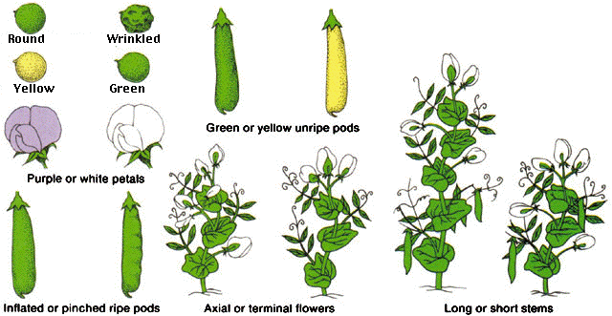
Pea Characteristics
Trait on left is dominant. Trait on the right is recessive.
Notes:
Cell theory had only recently been formulated by a number of scientists, from the Czech J.E. Purkinje (1787-1869) (also famed for his study on the conductive tissue of the heart)- who, in 1837, observed a parallel between the structure of plant and animal tissue - through the German botanist Matthias Schleiden (1804-1881)[i], who proposed that all plant tissue is composed of nucleated cells, to another German scientist, Theodor Schwann (1810-1882), who suggested "cellular formation" for both plant and animal tissue. Contrary to Schleiden, Unger showed that plants cells originate by division rather than by spontaneous formation. This would have been a crucial insight for Mendel. Furthermore, Schleiden's and Unger's emphasis on the need for "sharp" experiments, the application of mathematical laws to biology and botany, as well as their innovative definition of cells, profoundly influenced Mendel's thinking and method. Mendel was indebted to Unger's work on the role and behaviour of cells in pollination, and his observation of the production of new varieties through cross fertilisation, in particular the notion that this involved the union of just two cells. Through his experiments with pea plants, Mendel further explored the question of how the union of two cells produce a new organism, the enigma of generation. He concentrated on what, until then, had remained overlooked: the importance of considering pairs of observable characters and the statistical laws governing the pattern of their re-appearance in the off-springs. Naturally occurring hybrids were known to display characters belonging to both parents, as observed with respect to height and leaf distribution in the specimens of Primula from the 18th century Bobart's Herbarium. Applying the knowledge that he had gained through his study of experimental physics and mathematical sciences, Mendel developed special techniques of artificial pollination in order to control the crossing of species. Using these techniques he discovered that new patterns of combinations of characters would emerge in the hybrids if large enough numbers of plants were observed across several generations.

Slide 14
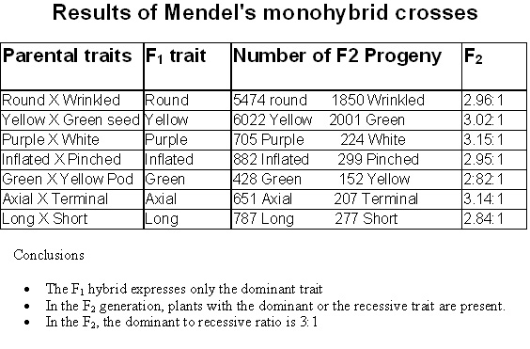
Notes:
One pair of characters that he studied was round versus wrinkled seeds. When pollen formed, a variety of plants with wrinkled seeds were used to cross pollinate plants for a variety with round seeds, all of the resulting hybrid seeds were round. Geneticists call the hybrid seeds or the plants the F₁ generation to distinguish them from the pure-breeding parents, the P₁ generation. Mendel also performed the reciprocal cross, in which plants from the variety with round seeds were used as the pollen parents and those from the variety with wrinkled seeds as the female parents. As before, all of the F₁ seeds were round.
Similar results were obtained when Mendel made crosses between plants that differed in any of the pairs of alternative characteristics. In each case, all of the F₁ progeny exhibited only one of the parental traits, and the other trait was absent. The trait expressed in the hybrids, Mendel called the dominant trait. The trait not expressed in the hybrids he called recessive.
The recessive trait reappears in the next generation when the hybrid progeny are allowed to undergo self-fertilization. Mendel counted 5474 seeds that were round and 1850 that were wrinkled. He noted that this ratio was approximately 3:1. The progeny seeds produced by self-fertilization of the F₁ generation constitute the F₂ generation.

Slide 15
Mendel's Laws of Inheritance
Law of Segregation - a gamete (sperm/egg) receives just one allele from each parent.
Law of Independent Assortment - different alleles/genes separate on their own (independently). Thus, color, height, pod shape, etc. are not connected together.

Slide 16
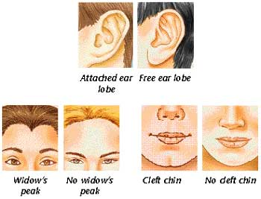
Terms to Know and Use
Trait – variations of a gene determined by alleles. (black/brown/blonde hair)

Slide 17
Terms to Know and Use
Allele – different forms of a gene. (represented by capital & lowercase letters - B or b)
Brown Eyes (B)
Blue Eyes (b)

Slide 18
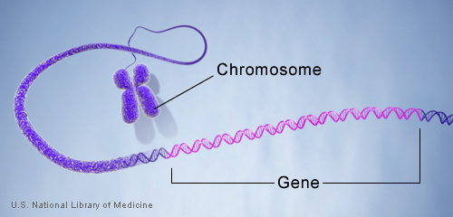
Terms to Know and Use
Gene – an inheritable feature on a
chromosome. (hair color, eye color, etc.)
Locus – the location of a gene, or allele, on a chromosome.

Slide 19
Terms to Know and Use
Dominant trait - expressed over a recessive trait when both are present.
- Written as a capital letter.
Recessive trait - not expressed when the dominant trait is present.
- Written as a lowercase letter.

Slide 20
Terms to Know and Use
Homozygous – when both alleles of a gene are
the same. (Pure-bred or True-bred.)
- Written as 2 capital or 2 lowercase letters.
Heterozygous – when the two alleles are not
the same. (Hybrid.)
- Written as 1capital and 1 lowercase letter.

Slide 21
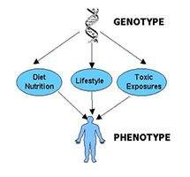
Terms to Know and Use
Genotype - the type of genes on a chromosome. (genetic combination)
Phenotype - the way genes are seen or expressed. (physical appearance)

Slide 22
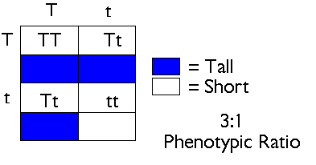
Terms to Know and Use
Monohybrid cross – gene exchange involving parents differing in only 1 trait.

Slide 23
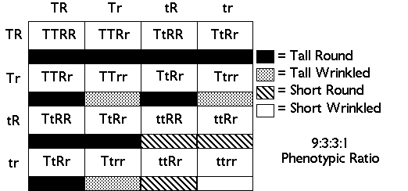
Terms to Know and Use
Dihybrid cross – gene exchange involving parents differing in just 2 traits.

Slide 24
A Mother contributes:
P Generation
( P = Parent)
A
or
A
A
AA
AA
A Father contributes:
or
A
AA
AA

Slide 25
A Mother contributes:
P Generation
( P = Parent)
A
or
A
a
AA
Aa
A Father contributes:
or
a
Aa
AA

Slide 26
A Mother contributes:
P Generation
( P = Parent)
A
or
a
A
Aa
AA
A Father contributes:
or
a
Aa
aa

Slide 27
A Mother contributes:
P Generation
( P = Parent)
A
or
a
a
Aa
Aa
A Father contributes:
or
a
Aa
Aa

Slide 28
A Mother contributes:
P Generation
( P = Parent)
a
or
a
a
aa
aa
A Father contributes:
or
a
aa
aa

Slide 29
Determining Unknown Genotypes
How do you know if a dominant phenotype is homozygous (AA) or heterozygous (Aa)?
Scientists can perform a test cross where they cross the unknown with a recessive (known) phenotype.

Slide 30
Mother contributes:
OPTION 1:
Test Cross
a
or
a
A
Aa
Aa
or
Father contributes:
A
Aa
Aa

Slide 31
Mother contributes:
OPTION 2:
Test Cross
a
or
a
A
Aa
Aa
or
Father contributes:
a
aa
aa

Slide 32
Mendel's Laws of Inheritance
Law of Segregation - a gamete (sperm/egg) receives just one allele from each parent.
Law of Independent Assortment - different alleles/genes separate on their own (independently). Thus, color, height, pod shape, etc. are not connected together.

Slide 33
Sex-Linked Traits
Sex Determination
Females – XX
Males – XY
Almost all sex-linked traits are found on the X chromosome
Y chromosome contains very few genes and is mainly involved in sex determination

Slide 34
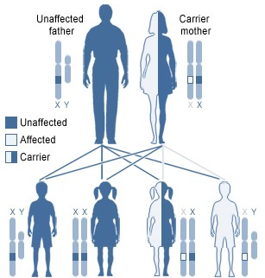
Sex-Linked Traits
It is possible for a female to be a carrier of an X-linked trait, but not express it
Men will express all X-linked traits they inherit
X-linked recessive, carrier mother
Unaffected
father
Carrier
mother
Unaffected
Affected
Carrier
Unaffected
son
Unaffected
daughter
Carrier
daughter
Affected
son
U.S. National Library of Medicine

Slide 35
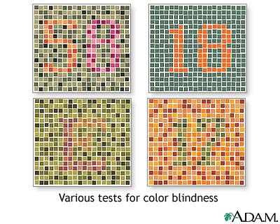
Example: Color Blindness
Various tests for color blindness.

Slide 36
PEDIGREE CHARTS
A family history of a genetic condition

Slide 37
What is a pedigree chart?
Pedigree charts show a record of the family of an individual
They can be used to study the transmission of a hereditary condition
They are particularly useful when there are large families and a good family record over several generations.
© 2007 Paul Billiet ODWS

Slide 38
Studying human genetics
You cannot make humans of different types breed together
Pedigree charts offer an ethical way of studying human genetics
Today genetic engineering has new tools to offer doctors studying genetic diseases
A genetic counsellor will still use pedigree charts to help determine the distribution of a disease in an affected family
© 2007 Paul Billiet ODWS

Slide 39
Symbols used in pedigree charts
A marriage with five children, two daughters and three sons. The eldest son is affected by the condition.
Normal male
Affected male
Normal female
Affected female
Marriage
Eldest child ↔ Youngest child
© 2007 Paul Billiet ODWS

Slide 40
Organising the pedigree chart
A pedigree chart of a family showing 20 individuals
© 2007 Paul Billiet ODWS

Slide 41
Organising the pedigree chart
Generations are identified by Roman numerals
I
II
III
IV
© 2007 Paul Billiet ODWS

Slide 42
Organising the pedigree chart
Individuals in each generation are identified by Arabic numerals numbered from the left
Therefore the affected individuals are II3, IV2 and IV3
I
II
III
IV
© 2007 Paul Billiet ODWS

